Slide 1
STOCK PRICE PREDICTION USING LSTM
TEAM MEMBERS:
M.SUNIL KUMAR-99220040917
L.NAGARAJU-99220040906
M.PRANAV-99220040916

Slide 2
ABSTRACT
In this topic we apply Long Short Term Memory (LSTM) networks to stock price prediction for forecasting accuracy in the years of volatile financial markets. Using historical data of stock prices we created a predictive model that accurately captures low dimensional temporal dependencies in stock price movements. Our approach consists of two steps: data preprocessing to refine features and training of LSTM for different time intervals. It makes use of KPIs such as MAE or RMSE to assess performance. We show that LSTM networks substantially improve over all baseline forecasting techniques. This study serves to build on the current literature regarding machine learning approaches to finance and support the utilization of deep learning methodologies to some non-linear.

Slide 3
LITERATURE SURVEY
S.NO | PAPER DESCRIPTION | TECHNIQUES USED | LIMITATIONS
1. | S. R. Suralkar and S. H. Patil these two studied and evaluated the performance of various machine learning algorithms | Support Vector Machines Random Forest, and Long Short-Term Memory (LSTM) neural networks | difficulty in market sentiments accurately and handling non-stationary market data.
2. | P. B. Revankar and S. B. Lakshmanna: survey provides an overview of different ml techniques applied to predict. | regression models, ensemble methods, and deep learning approaches. | labeled data and the noise in financial news sentiment analysis.
3. | A. Kumar et al.: This research explores the integration of sentiment analysis with machine learning models to predict . | It investigates how sentiment from news articles and social media can predicte accuracy. | the potential overfitting of ensemble models to historical data.
4. | M. N. Nazar and R. K. Ibrahim: This review paper summarizes the recent advancements in ml to predict. | It discusses the challenges, methodologies, and future directions in the field. | challenge of accurately modeling volatility.
5. | "Deep learning for stock prediction using numerical and textual information" by Z. Zhang et al. | It demonstrates the deep learning models in capturing complex market patterns. | need for large datasets for and the risk of transferring irrelevant patterns.

Slide 4
PROBLEM STATEMENT
Data Preprocessing: Preprocess the data by cleaning, normalizing, and transforming it into a format suitable for machine learning models. This may involve techniques such as data imputation,feature engineering, and data scaling.
Feature Selection: Identify the most important features that influence stock prices using statistical analysis or machine learning techniques such as feature importance rankings or principal component analysis.
Model Selection: Choose a suitable machine learning algorithm for predicting stock prices. This may include regression techniques such as linear regression, decision trees, or neural networks.
Model Training: Train the selected model on the preprocessed data. This involves splitting the data into training and validation sets, fitting the model to the training data, and evaluating itsperformance on the validation set. This process may involve hyperparameter tuning to optimize the model's performance.
Model Deployment: Deploy the trained model to predict stock prices for new data. This may involve integrating the model into a web application, a mobile app, or an API that can receive inputs and provide predictions.

Slide 5
ISSUE IN EXISTING SYSTEM
ACCURACY
REQUIRES LARGE DATA
OVERFITTING
DIFFICULTY IN MODELING NON-LINEAR RELATIONSHIPS
DATA PREPROCESSING COMPLEXITY

Slide 6
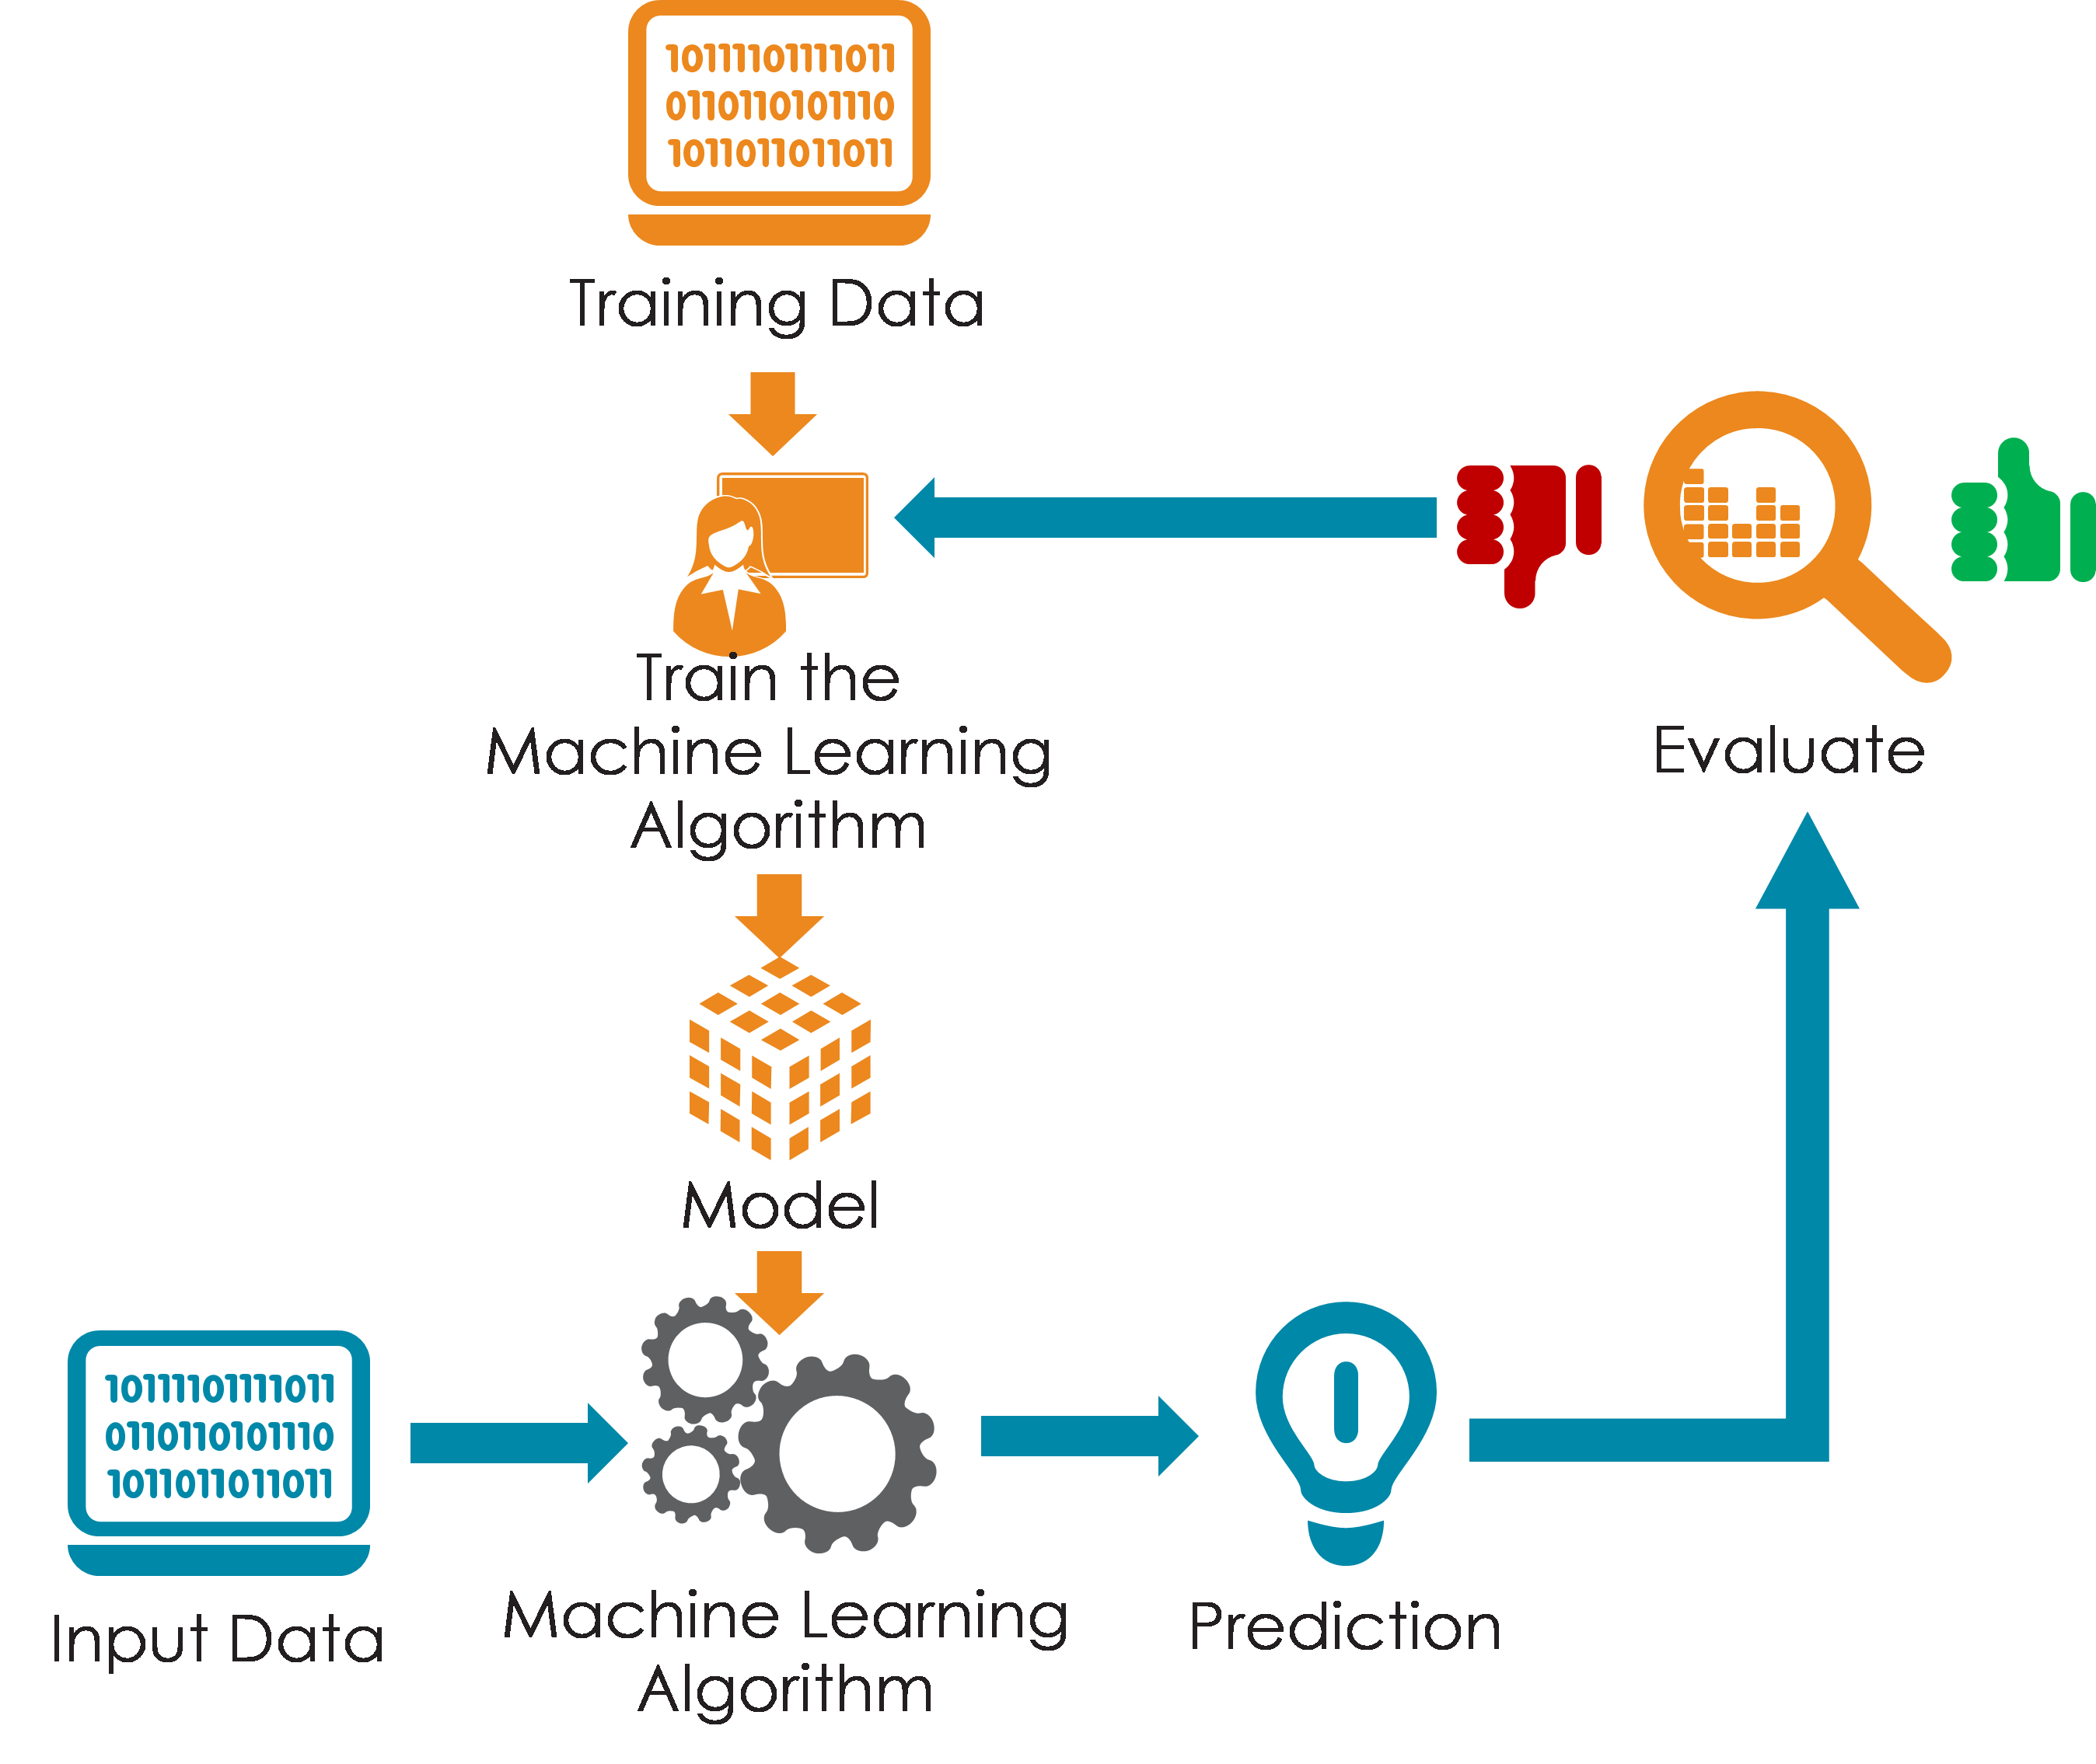
PROPOSED SYSTEM
Data Collection: Gather diverse data sources including historical stock prices, market indices, economic indicators, news sentiment, and social media sentiment.
Data Preprocessing: Cleanse and preprocess the collected data, handling missing values, outliers, and inconsistencies. Normalize or scale features as necessary for model training.
Model Selection: Evaluate various machine learning algorithms suitable for time-series forecasting, such as Support Vector Machines (SVM), Random Forest, Gradient Boosting, and Long Short-Term Memory (LSTM) neural networks.
Model Training: Train multiple models using historical data, tuning hyperparameters through techniques like cross-validation to optimize performance and mitigate overfitting.
Ensemble Methods: Implement ensemble methods such as bagging, boosting, or stacking to combine predictions from multiple models, enhancing overall accuracy and robustness.
Evaluation Metrics: Assess model performance using appropriate evaluation metrics such as Mean Absolute Error (MAE), Mean Squared Error (MSE), or Root Mean Squared Error (RMSE) on validation data.

Slide 7
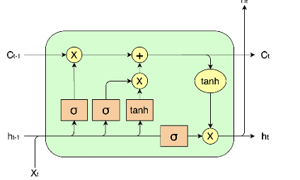
BUILDING LSTM MODEL
Importing the required libraries to build an LSTM model to predict AAPL stock price, TensorFlow and Keras . We preprocess the dataset such that it contains information like open price, close price, adjusted close price, trading volume. If data is separated into training and testing, around 70–80% of data is used for training . Each sequence of the data corresponds to a time window of stock prices in the past . The Keras Sequential API is used to build up the architecture of the LSTM model. In a model , after an LSTM layer are one or more thick layers.Sequence length is the length of each input sequence and number of features is the number of features used for prediction. This describes the sequence length of the input to the LSTM layer[16]. You can add dropout layers to prevent overfitting A model by itself is comprised of a loss function (MSE) for regression tasks on average) and a chosen optimizer such as Adam. The batch dimension and the training fee, this requires tuning hyperparameters in order to achieve best performances. Then, we train the model using the training data set to predict the future stock prices based on its past data. Lastly, accuracy and generalization are measured by (MAE) and (RMSE) , respectively which compare predicted and observed sets of data. We evaluate our model on the testing dataset. Effective Model construction; strong LSTM-based stock price prediction models for AAPL.

Slide 8
SOFTWARE REQUIRED
SOFTWARE: GOOGLE COLLAB
PAST DATA SET
VERSION:3.10

Slide 9
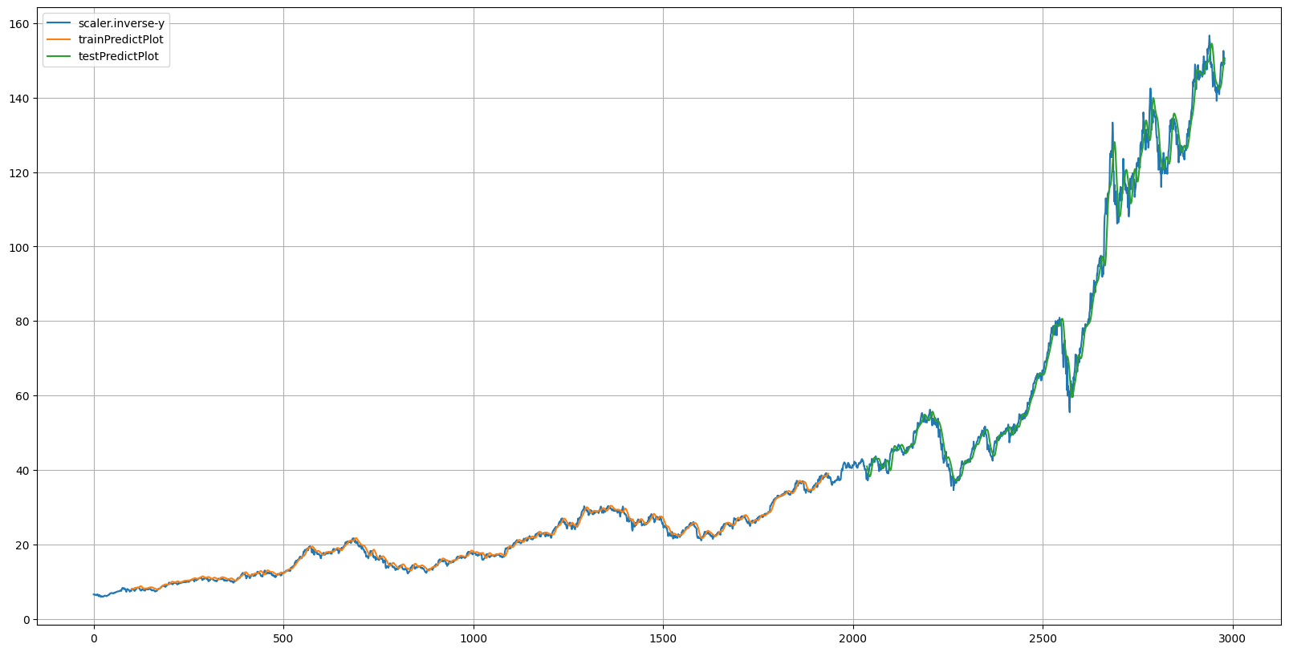
Output

Slide 10
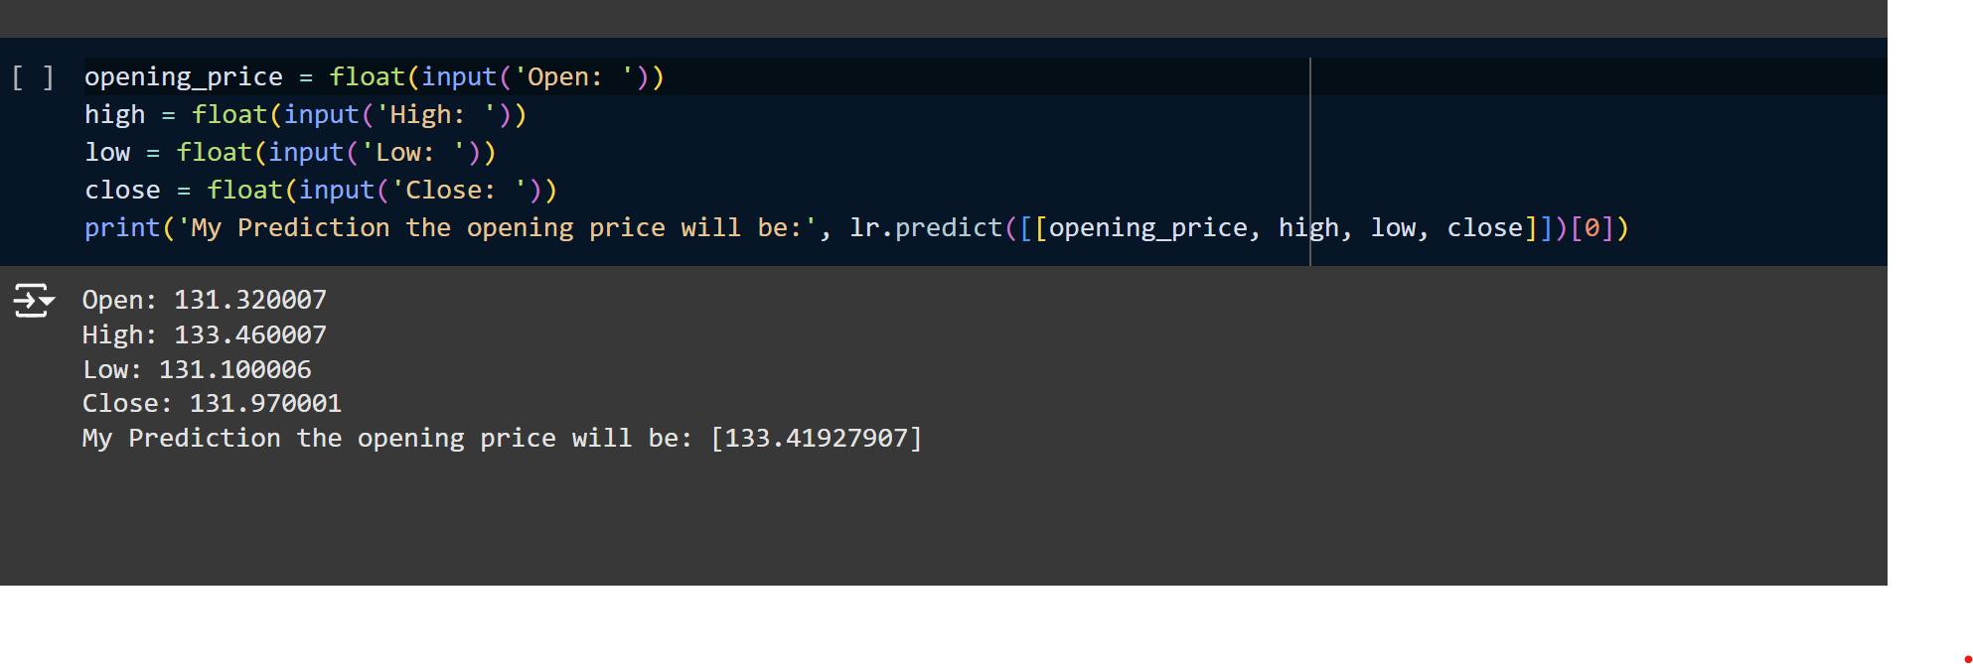
Our predication

Slide 11
CONCLUSION
In conclusion, stock price prediction using machine learning presents immense potential but also notable challenges. While machine learning techniques offer the capability to leverage diverse data sources and advanced algorithms for prediction, issues such as data quality, overfitting, and market dynamics pose significant hurdles. Despite these challenges, ongoing research and development efforts continue to refine models, enhance interpretability, and improve predictive accuracy. With the integration of domain expertise and robust validation techniques, machine learning-based stock price prediction holds promise for providing valuable insights to investors and financial analysts in navigating the complex and dynamic nature of the stock market.

Slide 12


